Slide 1
经济学原理：第一讲
蔡洪滨
北京大学光华管理学院

Slide 2
Chapter 1: Central Concept
A. Why Study Economics
B. The Three Problems of Economic Organization
C. Society’s Technological Possibilities

Slide 3
1A: Why Study Economics
Economics helps you understand the changing world
  Economic growth
  Financial crisis
  Inequality
Economics helps you understand social and economic phenomena:
  Housing prices
  Wage changes
Economics helps you understand firm and organizational behavior:
  Iphone: Apple
  Pricing
Economics helps you understand individual behavior
  Herding behavior
  Gift-giving
Economics helps you understand yourself

Slide 4
1A: Why Study Economics Principle
It is a required course.
It is the foundation of all economics and management courses you will take later.
It is a course that will open your mind. It introduces you the basic economics ideas and approaches, the beauty of economic thinking.
It is a course that may change your life.
“Practical men, who believe themselves to be quite exempt from any intellectual influences, are usually the slaves of some defunct economist.” “But, soon or later, it is ideas, not vested interests, which are dangerous for good or evil.”------Keynes

Slide 5
How to study Economics Principle
It is perhaps the first course that requires you to develop a totally new learning approach.
Open your mind:
  Abandon test-driven mentality (放弃考试文化的惯性）
  Critical thinking
Open your eyes:
  Learn how to use what you learn to understand and analyze real life issues
Open your mouth:
  Learning through discussions and debates. （小班教学）

Slide 6
What is economics about
Economics is about resource allocation.
  Scarcity of resources: relative to desires.
  Efficiency: how to allocate scarce resources to satisfy the needs of the society (to maximize social welfare).
  Pareto Efficiency: an allocation is efficient if no one can be made better off unless someone else is made worse off.
The scope of economics has been expanding: the imperialism of economics
  All kinds of social and economic behavior and phenomena.
  Analytical tools of economics are adopted by other social sciences.

Slide 7
Organizational Structure of Economics
Microeconomics (微观，个体）
  Microeconomics theory
  Industrial organization
  Labor Economics
  Health Economics
  Development Economics
  Public Finance
Macroeconomics (宏观，总体）
  Macroeconomics theory
  Economic Growth
  International Trade and International Finance
Econometrics
Economic History, Political Economy, Behavior Economics, ….

Slide 8
The Logic of Economics
Economics is a social science with a well developed framework and a rich set of analytical tools to understand the rules of the economy. (to discover truth).
  经世济民？
Scientific Approach of Economics
  Theoretical analysis: develop hypotheses.
  Economic modeling: simplification, “all models are wrong, but some are useful”
  Empirical analysis: using econometrics to test hypotheses
  Historical and institutional analysis:
  Experimental analysis: controlled environments (in lab and in field) to test hypothesis

Slide 9
The Logic of Economics
Economics tries to discover causal relationships
  Time sequencing events or statistical correlations are not causal relationships: the post hoc fallacy.
    Correlation may have nothing to do with causality: temple dust
    Correlation may indicate reverse causality: death rate and hospital quality
    Correlation may reflect a different causality: ants and rain
  To find out whether factor X affects factor Y, we need to hold other factors Z, W, …constant: the failure to hold other things constant:
    20 years ago air quality was better without environmental protection law
  Sometimes we need to consider interactions of many factors (general equilibrium effects): the fallacy of composition.
Positive and Normative economics
  Positive economics: how things are (no value judgments)
  Normative economics: how things should be (value judgments)

Slide 10
Economics: Using cool heads to inform warm hearts
Economics is sometimes perceived as “cold”:
  A basic assumption of economics is rationality: individuals, firms and organizations make optimal choices to maximize their welfare. Decisions are based on careful cost and benefit analysis.
  Are we always so selfish? How about friendship, altruism, love, cooperation, public interests…..?
  Should the society be so materialistic? How about value, life, environment, equality, helping the others?
  How about “From each according to his ability, to each according to his need”

Slide 11
Economics: Using cool heads to inform warm hearts
In defense of the economic approach:
  Selfishness is one fundamental drive of human race: people are economic animals; evolution process
  Specialization: Economics studies human behavior and social and economic issues from this important perspective. Other social sciences focus on other perspectives.
  Other concerns (preferences) can be easily incorporated into economic analysis. In fact, they are all the time.
Warm hearts must be combined with cool heads
  Many human disasters are caused by warm hearts with “hot” heads：the road to hell is paved with good intentions.
  “If you are not a liberal at twenty, you have no heart; if you are not a conservative at forty, you have no mind.” ------Winston Churchill
  An economist should have both cool heads and warm hearts.

Slide 12
1B: Three Problems of Economic Organization
What to produce?
  Food, clothes, cellphones, books….
  Movies, videos, …
  Military goods, education, ….
How to produce?
For whom to produce?

Slide 13
1B: Three Problems of Economic Organization
Different economic systems:
Market Economy---------------------------------------------------Command Economy
Mixed economy

Slide 14
1C: Technological Possibilities
Production: inputs-----technology----outputs
Inputs (factors of production):
  Land
  Labor
  Capital
Production-Possibility Frontier
  Given technology and inputs, the maximum bundles of outputs (goods and services) can be produced.
Productive Efficiency: if on the PPF.

Slide 15
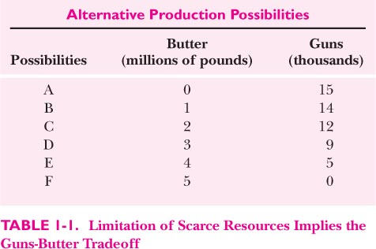

Slide 16
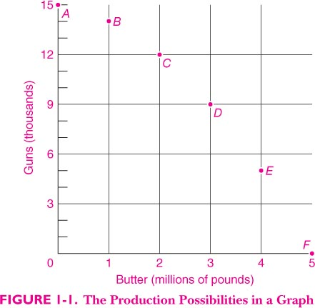

Slide 17
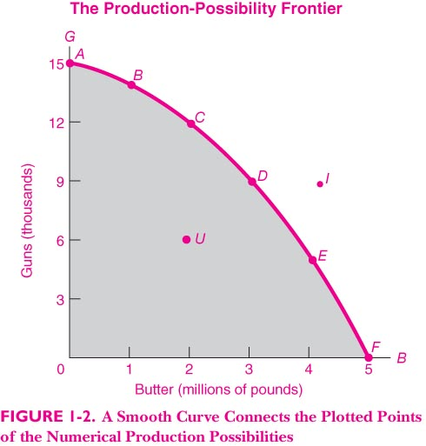

Slide 18
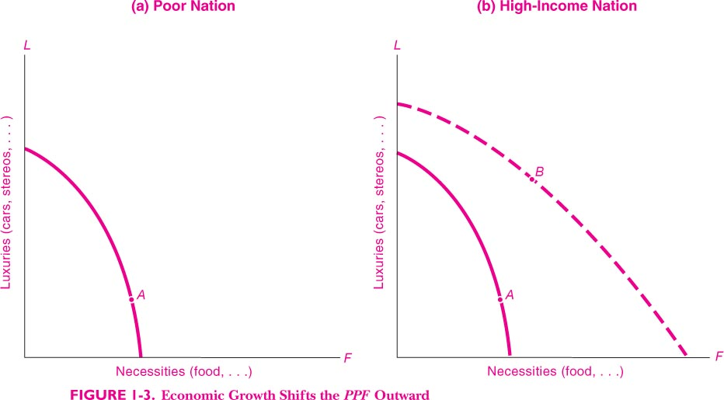

Slide 19
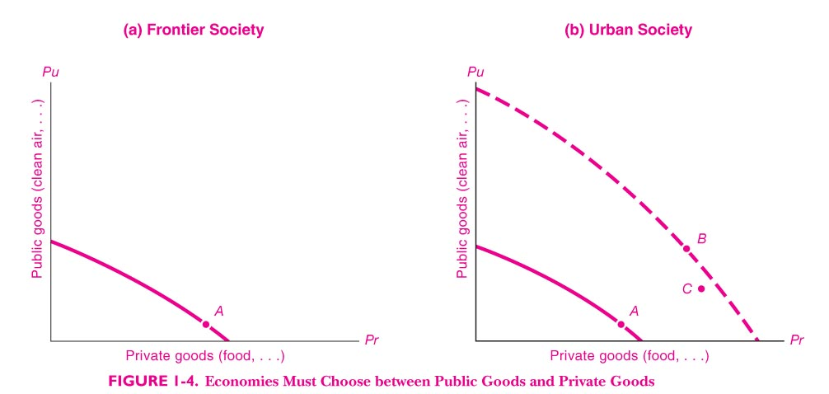

Slide 20
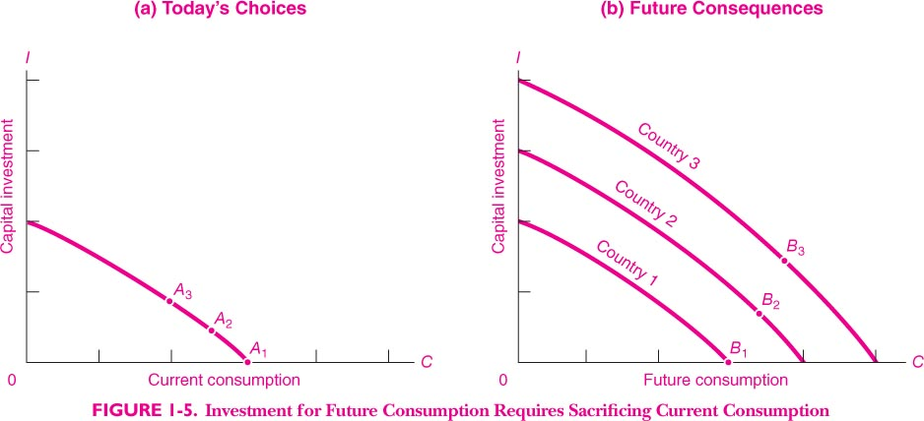

Slide 21
Opportunity Costs
Robert Frost (1874–1963): The Road Not Taken
Two roads diverged in a yellow wood,
And sorry I could not travel both
And be one traveler, long I stood
And looked down one as far as I could
To where it bent in the undergrowth;
Then took the other, as just as fair,
And having perhaps the better claim,
Because it was grassy and wanted wear;
Though as for that the passing there
Had worn them really about the same,
And both that morning equally lay
In leaves no step had trodden black.
Oh, I kept the first for another day!
Yet knowing how way leads on to way,
I doubted if I should ever come back.
I shall be telling this with a sigh
Somewhere ages and ages hence:
Two roads diverged in a wood, and I—
I took the one less traveled by,
And that has made all the difference.

Slide 22
Opportunity Costs
“There is no free lunch in life.”
PPF: increasing the output of one good X must give up some quantity of other goods, because a certain amount of resources need to be shifted from other goods to producing more good X.
The Opportunity Cost of one decision is the value of the best alternative forgone.
  If you are thinking of taking a choice A, and there are alternative choices B, C, D, ……… If among all these alternatives, B gives you the highest value V(B). Then the opportunity cost of A is the V(B).
What is your opportunity cost of coming to this class today?

Slide 23
Reminder:
  Review
  Preview
  Thank you!

